Slide 1
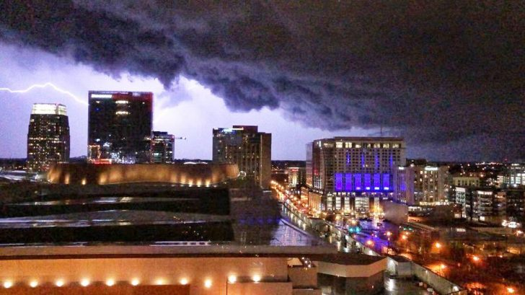
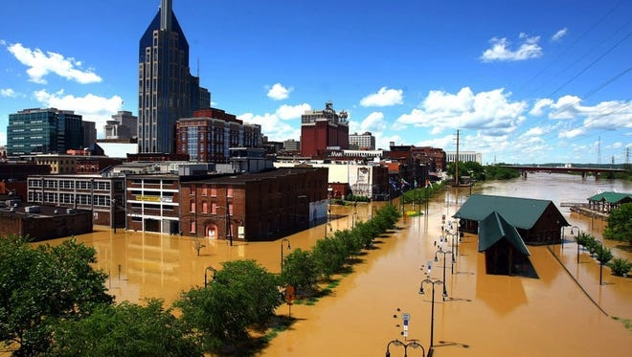
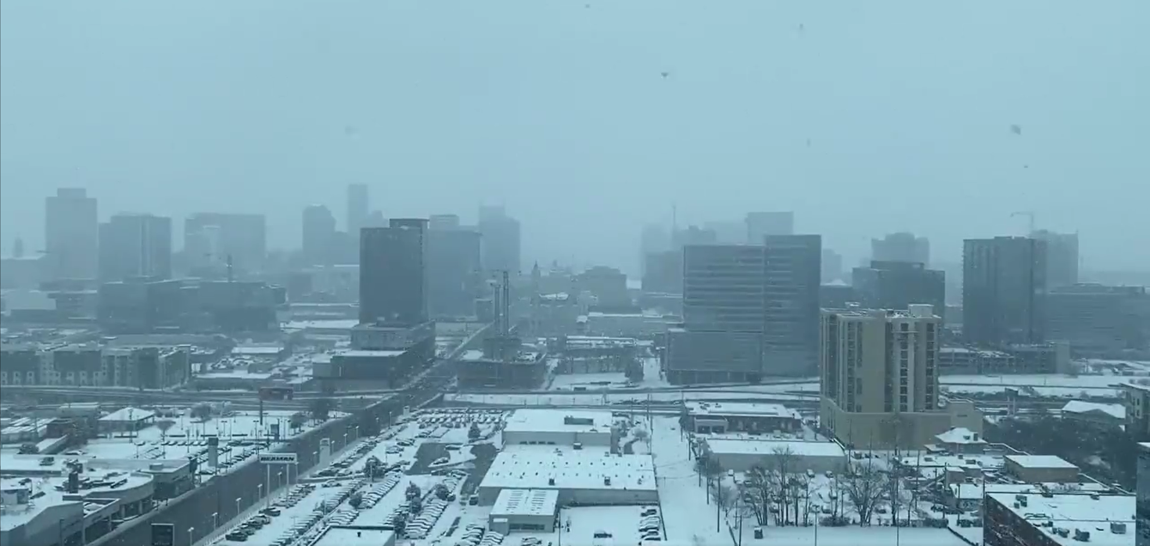
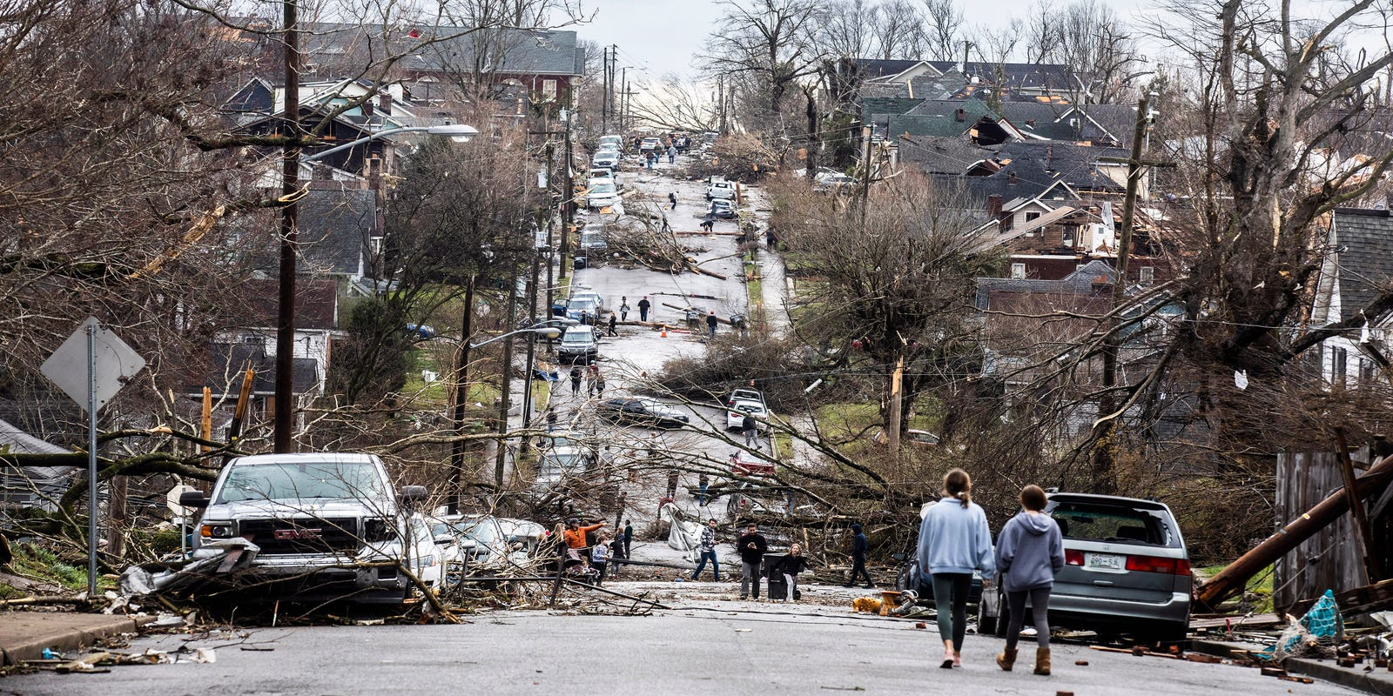
Type of Events
The following information will focus on damage cost and financial relief related to weather events in Davidson County, TN. The datasets also contained COVID data that has been filtered out. The reoccurring focus of events will be Severe Storms/Floods, Tornadoes, Winter Storms and a Hurricane.

Slide 2

REFERENCES
The raw datasets used for this analysis are provided from FEMA’s National Emergency Management Information Systems (NEMIS). The datasets are available at the links below. Additional information may be found as well for additional analysis.
Public Assistance (Infrastructure):
https://www.fema.gov/openfema-data-page/public-assistance-funded-projects-details-v1
Housing Assistance (Owners):
https://www.fema.gov/openfema-data-page/housing-assistance-program-data-owners-v2

Slide 3
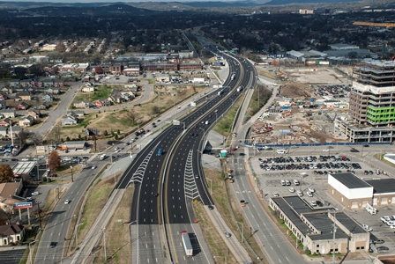
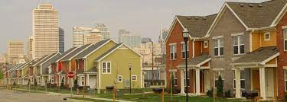
The Data
The two FEMA datasets used in the following analysis will focus on Public Infrastructure details and Housing Assistance Program for House Owners after weather related events impacted Davidson County, TN.
The datasets will span a timeframe of 1999 – 2021.
The information only reflects claims submitted requesting financial relief after a major weather-related event.
FEMA has several terms they use specifically to categorize their data, which will be explained during the analysis.

Slide 4

Nashville FEMA Declarations
Matthew Lintemuth
Nashville Software School
Data Analytics Cohort 4
https://www.linkedin.com/in/matthewlintemuth/

Slide 5

Noteworthy Mentions
Depending on the incident type (flood, tornado, etc.) will affect the types of assistance available.
The federal share of the Public Assistance is typically 75% of the total cost of the project.
Housing Assistance is paid based on if you are eligible under the IHP program guidelines.
Housing Assistance aide is broke down into 3 categories that make up the total approved amount. (Repair/Replace, Rental, Other)
Repair – Dollar amount for repairs and/or replacements.
Rental – Dollar amount for rental assistance. Not renters ins.
Other – Dollar amount for personal property, transportation, medical . care funeral, tools, storage, miscellaneous.

